Slide 1

Capstone Airbnb Data Analysis
Swaty Rao

Slide 2
Visualizations

Slide 3
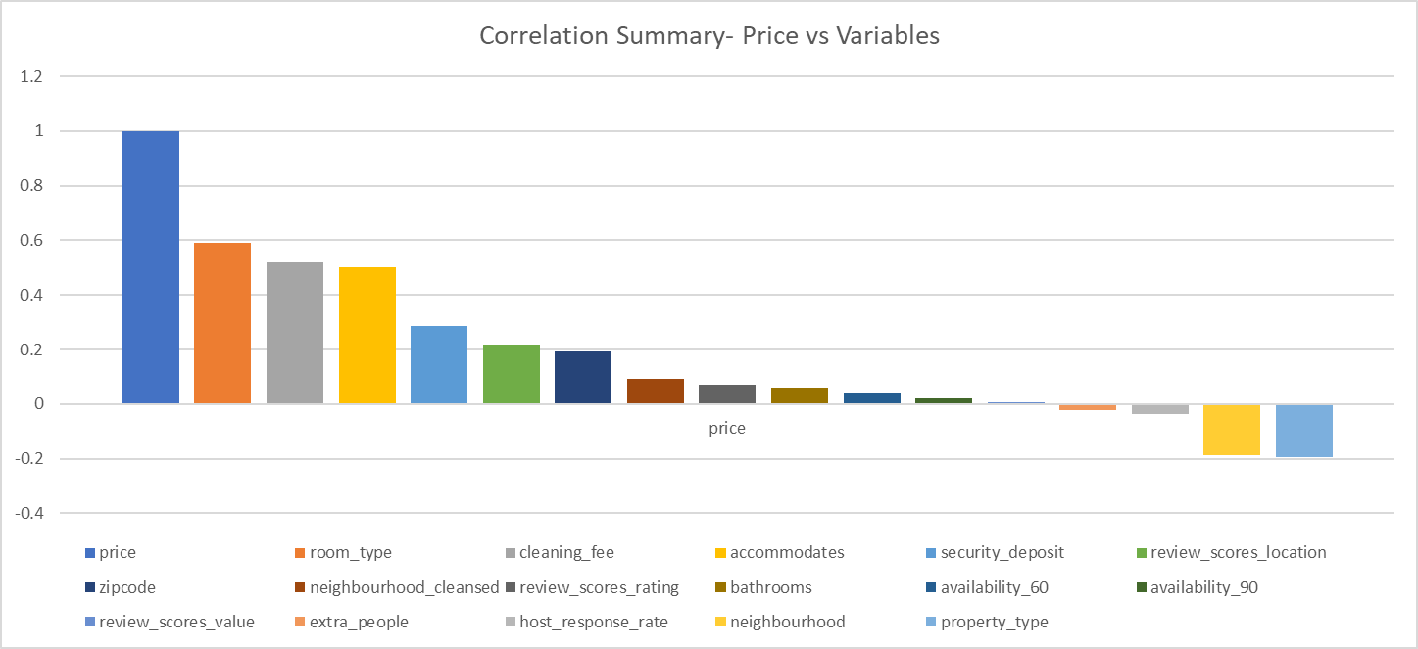
Per the correlation summary below, the top factors that have a strong positive association with dependent variable Price (values closer to 1) are: Room type, Cleaning Fee, Accommodates, Security Deposit, Review scores for Location and Neighborhood. This indicates that these factors affect the rental Price per night.

Slide 4
Inferential Statistics

Slide 5
Inferential Statistics – Regression Analysis
P values are smaller than 0.05 indicating that the coefficients have an effect on Price and indicative of a good regression. This set had the highest R squared of 0.49 as compared to the previous regressions. This means 49% of the variance in Price is explained by the regression equation, not very high but can be still considered good
 | Coefficients | P-value
Intercept | -109.8083831 | 7.54154E-11
host_response_rate | -51.48947745 | 1.05613E-10
accommodates | 9.466625885 | 9.9921E-65
bathrooms | 6.881093203 | 3.88204E-05
security_deposit | 0.016195782 | 6.15742E-09
cleaning_fee | 0.268924182 | 8.05247E-31
extra_people | -0.186740309 | 0.000129507
availability_60 | 0.511905432 | 4.26785E-08
availability_90 | -0.287586454 | 2.92997E-06
review_scores_rating | 1.038856281 | 5.80224E-10
review_scores_location | 10.50404859 | 5.37515E-16
review_scores_value | -5.259084584 | 4.82771E-05
room_type | 19.16771407 | 1.1671E-127
neighbourhood | -0.141901058 | 1.05211E-21
neighbourhood_cleansed | 0.076068612 | 3.94077E-08
zipcode | 0.005318222 | 1.74295E-16
property_type | -2.248365447 | 2.12141E-15
Regression Statistics
Multiple R | 0.698072859
R Square | 0.487305716
Adjusted R Square | 0.485775856
Standard Error | 40.90576466
Observations | 5379

Slide 6
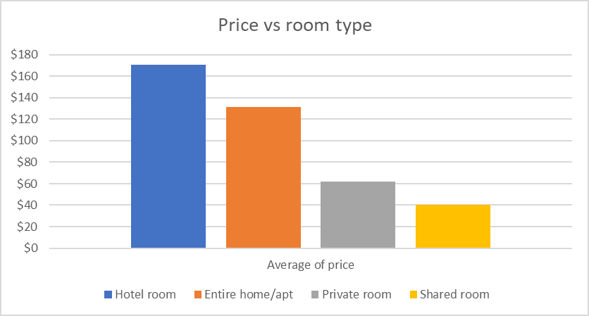
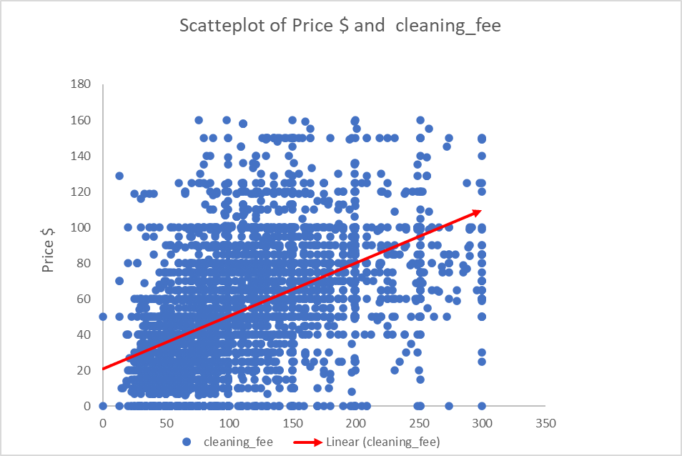
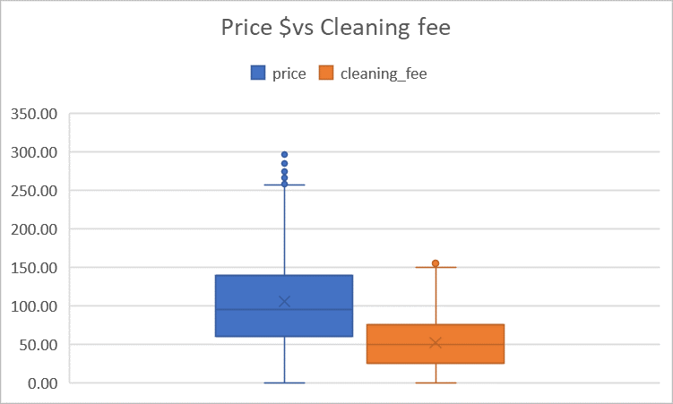
It appears in the adjacent graph that Room types- Hotel Room and Entire Apartment garner a higher average Price per night
Below scatterplot shows that most data points fall between price $50-$150 for cleaning fee when Price is between $10-$100
In the Boxplot below For a median price of $100 per night the median cleaning fee is $50

Slide 7
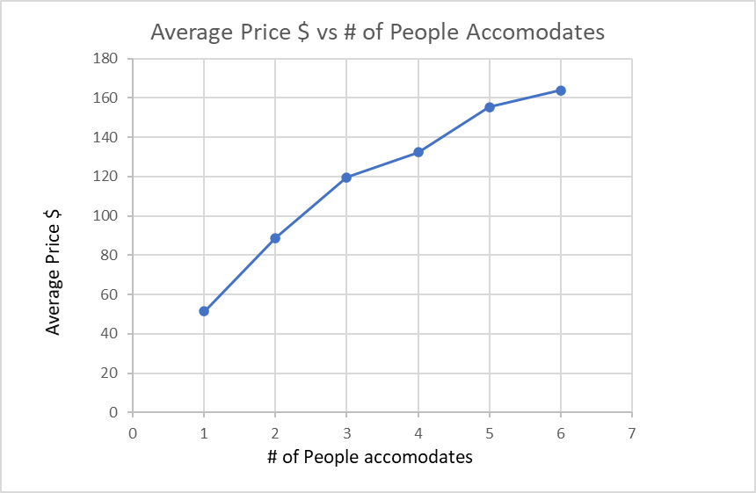
On an average Price per night has a positive relationship with the number of people that an Airbnb listing accommodates. Correlation coefficient for these 2 features was 0.50 which although not strong but still a positive correlation

Slide 8
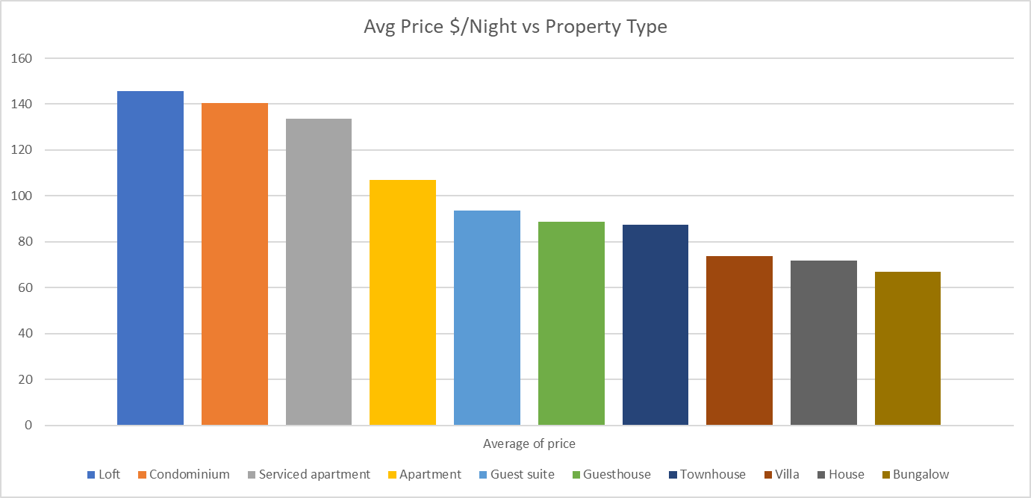
On an average Property types that have a higher Price per night (above $100/night) are Loft, Condominium, Serviced Apartment and Apartment.
Guest Suite, Guesthouse, Townhouse also have fairly good average Price/night between $80-$100.

Slide 9
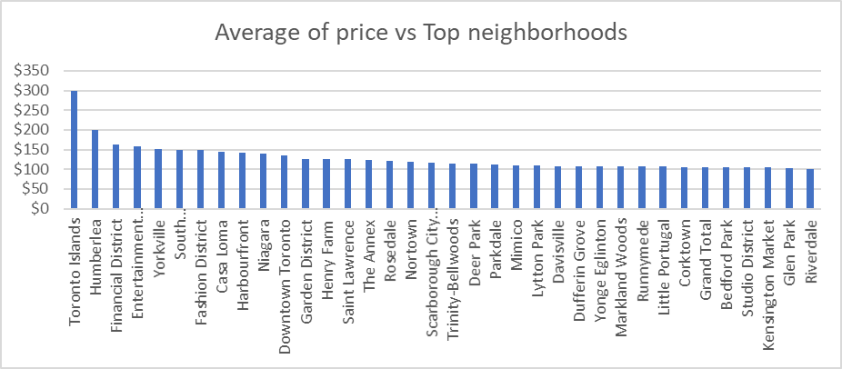
The Higher Price by Property Type in the previous slide relates to the graph below wherein the neighborhoods that have the average price/night above $100 are mostly in Toronto area which is an urban area.

Slide 10
Thank You.

